Slide 1
Nouns
A person, place or thing
Can include abstract nouns – nouns you can’t touch (love, joy)
Proper nouns are names and need capital letters (days of the week, months, countries, companies)

Slide 2
Adverbs
Describe the verb (add to the verb)
Tells you how, where or when a verb is performed
Find the verb, you find the adverb.
A lot of them end in ‘ly’ but there are plenty that don’t!
E.g. soon, yesterday, fast, almost.

Slide 3
Adjectives
Adjectives describe a noun
Find the noun, find the adjectives!
They can go before or after a noun
E.g. The red pen or the pen is red.

Slide 4
Verbs
They are doing words (jumping, throwing) or states of being (am, are, is, was, be)
A subject of a sentence performs the verb; find the subject, find the verb.
Tense questions are asking you about verbs – i.e. past tense, present perfect, progressive tenses
Verb form means the one or two words that form that tense!
E.g. verb form for past progressive =
He was jumping on the trampoline.

Slide 5
Pronouns
They replace nouns
There are three types:
personal (replace names) - e.g. he, she, it, you, us, them, we, her, him
possessive (show whose it is) – e.g. yours, mine, theirs, hers, its, ours
relative (start of relative clauses) – e.g. who, which, that, whose, where

Slide 6
Prepositions
They link two things together through position or time
It is a prepositional phrase if it DOES NOT have a verb
Be careful – words like before, after, since and until can be prepositions and subordinating conjunctions!
They are only subordinating conjunctions if they have a verb with them (After I eat dinner, Before I go to bed, Since it was 5pm,)
If they do not have a verb next to them, they are a prepositional phrase (e.g. after dinner, before bed, since 5pm,)

Slide 7
Determiners
They determine a noun – whose it is, how many there are, which one etc.
My pen a pen the pen five pens which pen that pen any pens
They go before a noun; find the noun, find the determiner!
Five types – quantifiers, articles, interrogatives, demonstratives and possessives
An is used before a word that starts with a vowel sound, not just a word that starts with a vowel
E.g. an hour (we don’t pronounce the ‘h’)

Slide 8
Conjunctions – 2 types
Co-ordinating – join two main clauses – sentences that make sense by themselves – FANBOYS
Subordinating – join a main and a subordinate clause – always go at the start of a subordinate clause – as, if, unless, until, when, since, before, after, because, although, whenever,
(before, since, until and after can be used as prepositions too!)

Slide 9
Subject and Object
Subject – performs the verb
Object – has the verb done to it
Both can go at the start or end of the sentence depending on whether it is active or passive
Active – SVO Passive – OVS
Label the S, V and O to determine whether it is passive or active
The verb is always in the middle so label that first!

Slide 10
Word Class
Noun – proper noun / abstract noun
Verb – doing word or state of being (am, are, is, be, were)
Adjective – describes a noun
Co-ordinating conjunctions – FANBOYS – 2 main clauses
Subordinating conjunctions – 1 main and 1 subordinate – always go at start of subordinate clause
Pronoun – 3 types – replace a noun
Adverbs – add to the verb – how, where or when – find the verb first
Adverbials – more than one word – follow them with a comma – they tell us how, where or when the verb is done
Prepositions – link two things – position of something and time between events
Determiners – before a noun (the, a, an, five, some, many, which, his, yours)
Subject and object – performs the verb – has the verb performed on it – verb always in middle!

Slide 11
Combining words
Relative clause – always starts with a relative pronoun – who, which, where, when, whom, whose, that (they add extra info the the noun)
The man, who is old, went to the shops.
The man has a dog, that is playful.
Noun phrases – starts with a determiner, can have an adjective or adjectives then a noun, then can have a prepositional phrase (NO VERBS!)
e.g.
The brown twig
A green pen with red stripes
That book about the Romans
The tower in the garden

Slide 12
Verb forms and tenses
Simple past – past tense of the verb (I went, ate, talked)
Simple present – present tense of the verb (I go, eat, talk)
Present perfect – has/have followed by past tense of the verb (have lived)
Past perfect – had followed by past tense of the verb (had grown)
Modal verbs – may, might, could, should, shall would, will, ought, can – don’t forget negatives – couldn’t, shouldn’t
Present progressive – am/are/is ing verb
Past progressive – was/were ing verb
Active – SVO Passive – OVS
Subjunctive – it is talking about a situation that hasn’t happened (mostly were – which one sounds like advice? Which one sounds like the Queen?)

Slide 13
Tense verb form – two words for all of these!
Present perfect – has/have followed by past tense of the verb (have lived)
Past perfect – had followed by past tense of the verb (had grown)
Present progressive – am/are/is then an ing verb
Past progressive – was/were then an ing verb

Slide 14
Punctuation
Capital letters – start of sentence, proper nouns, start of speech, I
Questions – question tags
Exclamation marks – they don’t show shouting, they show surprise or shock
Commas in lists – only need one comma – fronted adverbials may thrown in to trick you
Commas to clarify meaning – let’s eat grandpa let’s eat, grandpa
Commas before, after subordinate clauses and fronted adverbials
Inverted commas – lean inwards – capital letter at start then punctuation before they end (e.g. John said, “What is that noise?” or “What is that noise?” said John.)
Apostrophes – contraction (didn’t) – possession (Jamie’s) – will not becomes won’t! – they make sentences informal if they have been used for contraction ONLY!
Parenthesis – the effect – commas dashes brackets – sentence should still make sense without it
Colons : – introduce a list and separate main clauses
Semi-colons ; - longer items in a list and separate main clauses
Dash – separate main clauses or used for parenthesis – need 2 for this
Hyphens – join two or more words before a noun – always one less than amount of words being joined together! Sugar-free lollies
Bullet points – list the items with a comma after each one then a full stop at the end – no need for capital letters at the start of the item

Slide 15
Vocabulary
Synonyms – similar meanings
Antonyms – opposite meanings
Prefixes and suffixes – try all of them and see what sounds the most correct – eliminate
Word families – think about what the root word could mean in each one
percent centipede century

Slide 16
Standard English
Standard English – read them out and see which one sounds most correct – we were not we was!
Formal and informal – informal use contractions, apostrophes for possession doesn’t count as a contraction! Jamie’s dinner
Subjunctive – were – how the queen speaks

Slide 17
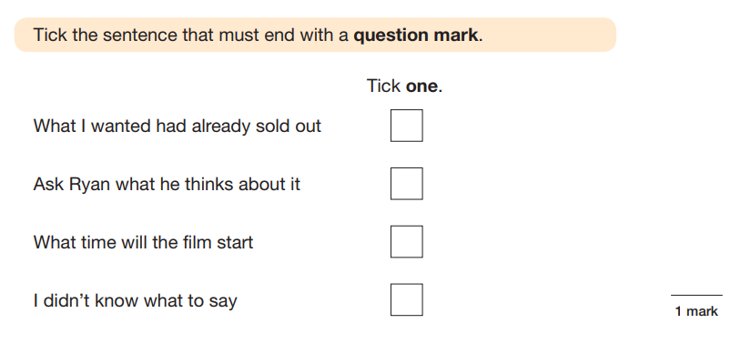
Elimination – ALWAYS eliminate the wrong answers first – this worked superbly last year!

Slide 18
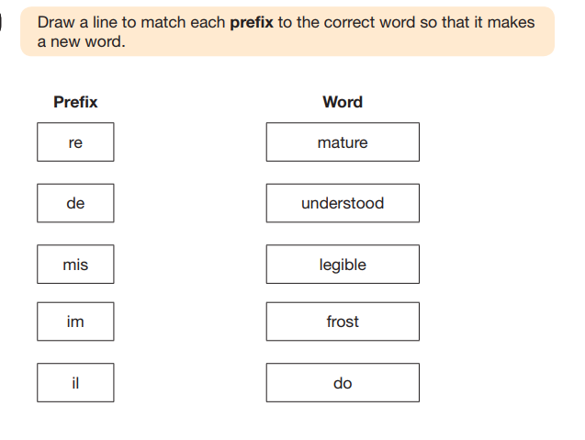
Try out all the possibilities

Slide 19
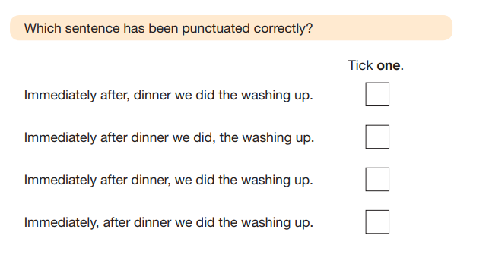
Read the sentences out loud and pause at the punctuation – this will help to make it obvious

Slide 20
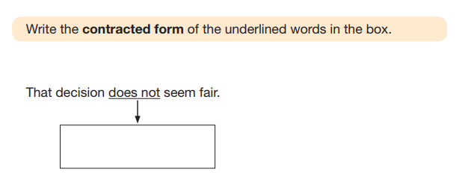
Do not join the apostrophe in a contraction!
Do not join the letters when writing a single word out!

Slide 21
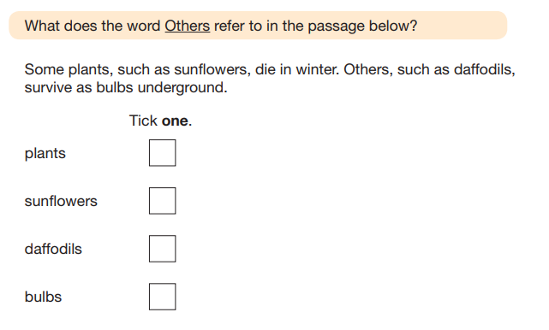
These Qs always refer to the 1st noun mentioned!

Slide 22
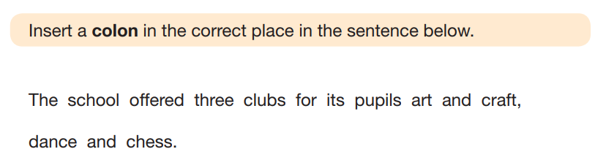
How to insert a piece of punctuation – put it in using your finger first to check! Make sure the punctuation is a similar size to the writing!

Slide 23

Different styles of question – read carefully!

Slide 24
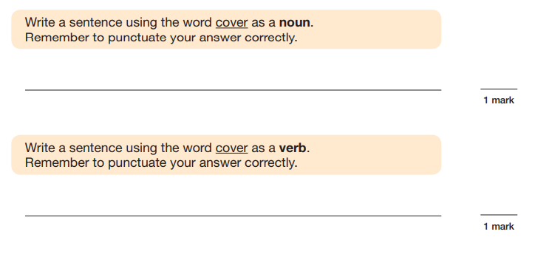
Noun = There is a ______.
Verb = I should _______.

Slide 25
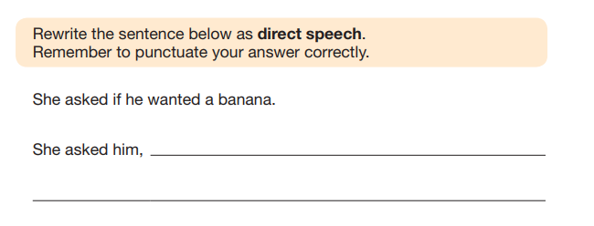
REMEMBER, PUNCTUATE CORRECTLY MEANS ZERO MARKS IF YOU LEAVE OUT PUNCTUATION!

Slide 26
Punctuation
Full stop .
Capital letter A
Hyphen -
Comma ,
Question mark ?
Exclamation mark !
Dash -
Semi-colon ;
Colon :
Bracket ()
Inverted commas “ ”
Bullet point .
Apostrophe ’
Parenthesis – – () , ,

Slide 27
Word Class
Noun
Verb - tense
Adverb
Adjective
Pronouns
Determiners
Noun phrases
Adverbials
Prepositions – prepositional phrases
Subject and Object

Slide 28
Sentence Functions
Exclamation – shows shock or surprise – starts with what or how
Command – tells you to do something, bossy verbs
Statement – tells you a piece of information
Question – needs an answer, question tags

Slide 29
Sentence Structure
Main clause – makes sense by itself!
Subordinate clause – doesn’t make sense by itself, always starts with a subordinating conjunction!
Relative clause – a type of subordinate clause, starts with a relative pronoun, always follows a noun, can go in the middle or the end of a sentence
Co-ordinating conjunctions – FANBOYS – for and nor but or yet so
Subordinating conjunctions – subordinate clauses always start with these!

Slide 30
Tense
Simple past – I went, we slept, she ran – verb form is one word
Simple present – I go, we sleep, she runs – verb form is one word
Past perfect – had then past tense verb – verb form is two words
Present perfect – has/have then past tense verb – verb form is two words
Past progressive – were/was then ing verb – verb form is two words
Present progressive – are/is/am then ing verb – verb form is two words
Subjunctive form – normally the word ‘were’/advice/a situation that hasn’t happened – which one sounds like the Queen
Modal verbs – could, should, would, will etc - negative forms as well – couldn’t, shouldn’t, wouldn’t
(cannot >>> can’t will not >>> won’t shall not >>> shan’t)
Passive and active – label SVO – verb is always in the middle

Slide 31
Vocabulary
Synonyms – similar MEANING
Antonyms – opposite MEANING
Prefixes and suffixes – try them all out and see which works – think about what the prefix does to the meaning of the word
Word families – think about the root and check any words you do know – what does the root in that word mean?
Formal and informal – contractions are informal! Possession isn’t!
Standard and non-standard English – ‘are’ and ‘were’ are plural, ‘is’ and ‘am’ are singular

